Slide 1
Functional Claiming in Chemical Applications Ricardo Moran Schwegman Lundberg & Woessner, PA May 2017

Slide 2
Functional Language
Claiming something by what it does or how it works, instead of what it is.
“an elongated strip”:
which is tear resistant but will tear completely if subjected to a force which would jeopardize the safety of the wearer in an amusement park environment.
“non-sagging and non-offsetting tungsten filaments . . . ” GE Co. v. Wabash Appliance Corp., 304 U.S. 364 (1938).

Slide 3
Functional Language
“Substantially pure carbon black in the form of commercially uniform, comparatively small, rounded, smooth aggregates having a spongy or porous interior.” United Carbon Co. v. Binney & Smith Co., 317 U.S. 228 (1942).
“Fragile gel.” Halliburton Energy Servs. v. M-I LLC, 514 F.3d 1244 (Fed. Cir. 2008).
“A method for selectively inhibiting PGHS-2 activity in a human host, comprising administering a non-steroidal compound that selectively inhibits activity of the PGHS-2 gene product to a human host in need of such treatment.” Rochester v. G.D. Searle & Co., Inc., 375 F.3d 1303 (Fed. Cir. 2004).

Slide 4
Advantages of Functional Language
Enables broader claim scope.
Ex parte Kolarov: “This functional limitation renders the claim quite broad, and covers essentially any embodiments that perform the recited function of matching a capacity of a communication network.”
Takes the place of structural language, where structural descriptions are not possible.
Adding difficulty to prior art searches that are conducted by an adverse party.

Slide 5
Disadvantages of Functional Language
When an attorney is contemplating filing a patent application, but first intends to conduct a prior art search, the presence of functional elements in the prior art can encumber the attorney’s prior art search.
Consequent increase in prior art rejections based on citations from technologies that are remote to the claims.
Functional element that is so broad and indistinct, that the functional element fails to confine the associated structural element to any particular dimension or substance.
Neglect to associate it with a bona fide structural element.

Slide 6
Takeaways
Functional elements in claims are good, in that they can take the place of structural language, where it is impossible or difficult to use structural language.
Functional elements are also good, in that they usually enable claim drafting that encompasses a broader range of structures than a corresponding structural element, thereby leading to broader claim scope.

Slide 7
Functional Language Advice
Use functional language with great care.
Make sure the functional term is defined thoroughly, including numerically.
Make sure there is at least one example of embodiments that perform the claimed function

Slide 8
Case Review 1
Inhibiting PGHS-2 activity in a human host by administering a compound that selectively inhibits activity of the PGHS-2 gene product.
PGHS-2 = Cyclooxygenase (COX) 2.
Were trying to cover Celebrex® and Bextra® for treating inflammation.
Perfectly good claim, had they actually disclosed a compound that achieved the claimed function.

Slide 9
Case Review 2
Fragile gel drilling fluid.
Had a definition in specification.
A gel that is easily disrupted or thinned under stress, but which quickly returns to a gel when the stress is alleviated or removed.
So “fragile” that may be disrupted by a mere pressure wave or a compression wave during drilling.
Suspends drill cuttings through its gel or gel-like characteristics, without need for organophilic clays to add viscosity to the fluid.
Relied on data.
Had no numerical fall-back positions.
Even though they had definition and data, the term was held indefinite.

Slide 10
Case Review 2
Fragile gel drilling fluid.
Patent holder’s failure to distinguish the fragility of the drilling fluids of the invention from the close prior art was fatal.
Under the patent holder’s proposed construction, an artisan would not know from one well to the next whether a certain drilling fluid was within the scope of the claims, because a wide variety of factors could affect adequacy.

Slide 11
Final Thoughts
Try not use functional language at the point of novelty.
Make sure the functional term is defined thoroughly, including numerically.
Make sure there is at least one example of embodiments that perform the claimed function.

Slide 12
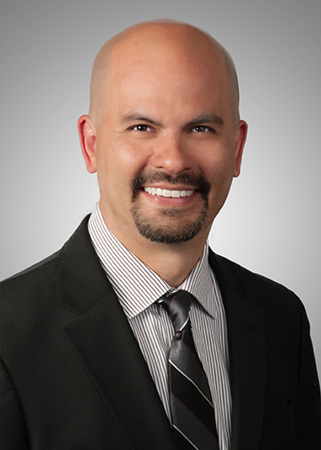
Questions or Comments?
Ricardo Moran
Principal & Registered Patent Attorney
Schwegman Lundberg & Woessner
Phone - (612) 349-9594
Email - rmoran@slwip.com

